Slide 1
CS 234 Session II
Model-free policy evaluation & control

Slide 2
Recap of lecture
Model-free policy evaluation
Monte Carlo (first-visit, every-visit, incremental)
Temporal Difference (TD(0), batch TD ⇔ certainty equivalence estimate)
Model-free control
Monte Carlo
SARSA
Q-Learning

Slide 3
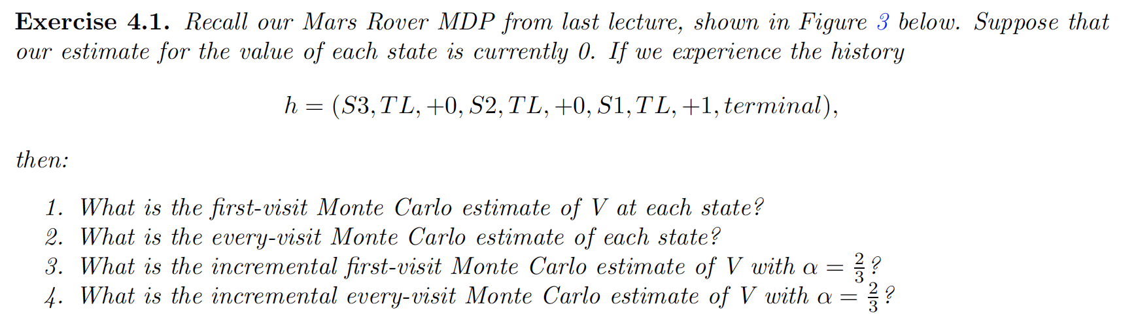
Exercise 1

Slide 4
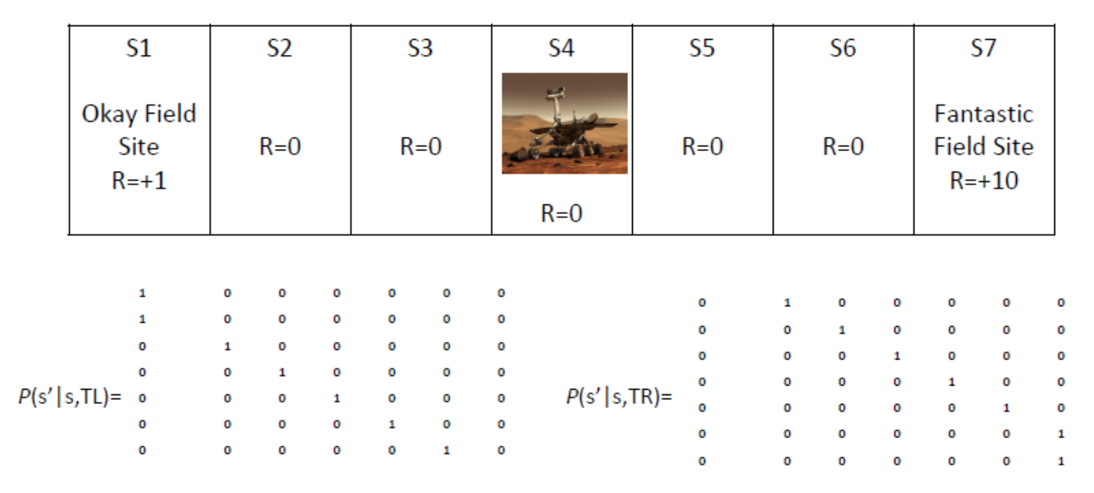
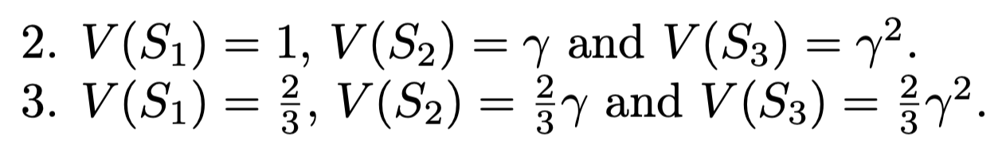
Exercise 1

Slide 5
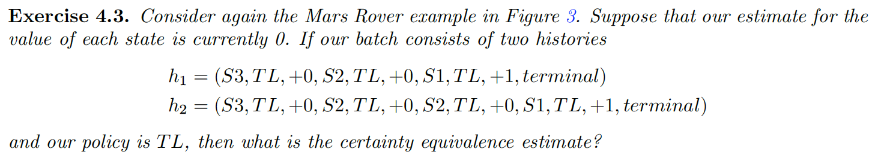
Exercise 2

Slide 6
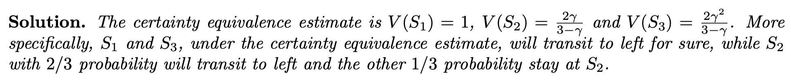
Exercise 2

Slide 7
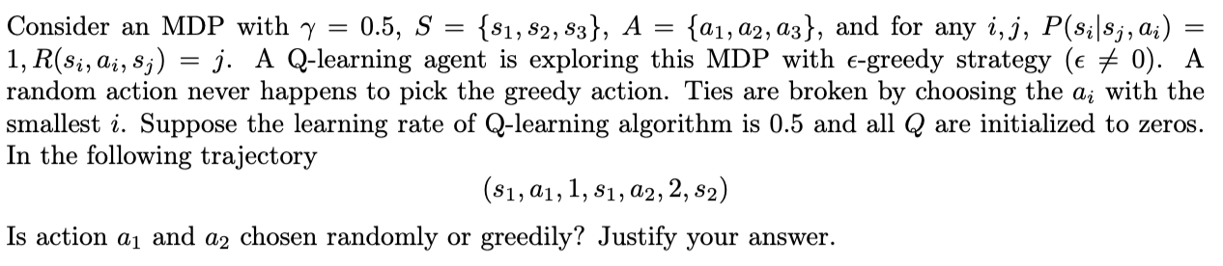
Exercise 3

Slide 8
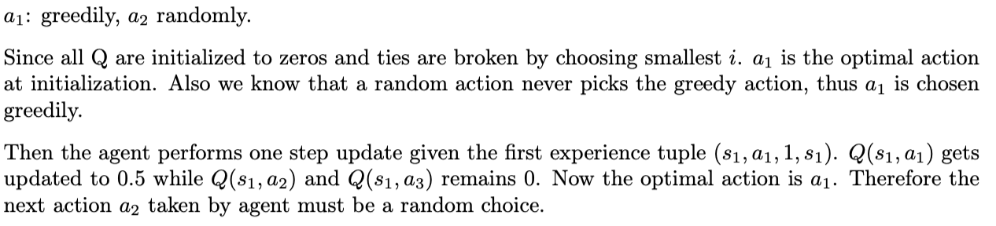
Exercise 3

Slide 9
Exercise 4

Slide 10
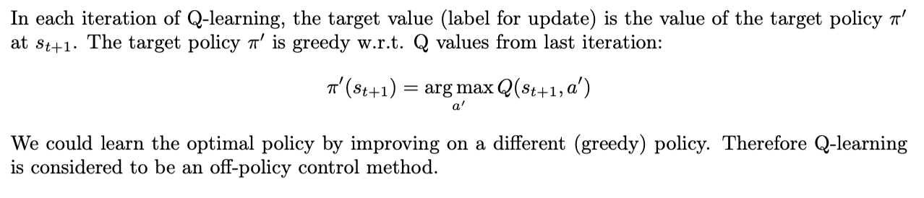
Exercise 4

Slide 11
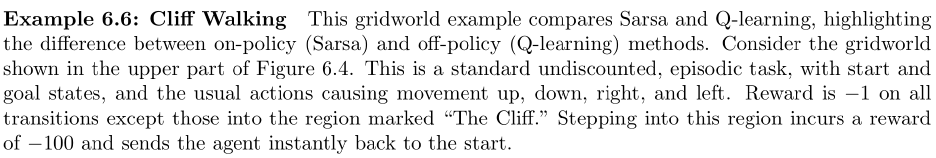
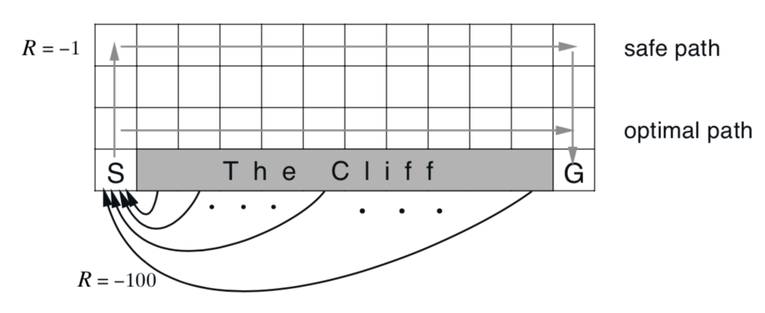
Difference between SARSA & Q-Learning

Slide 12
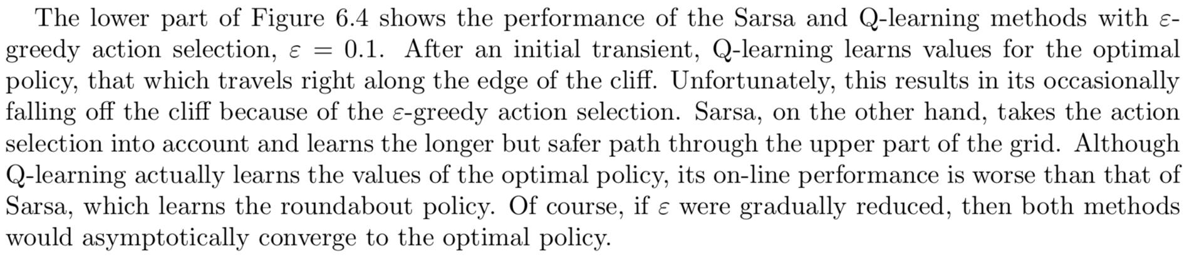
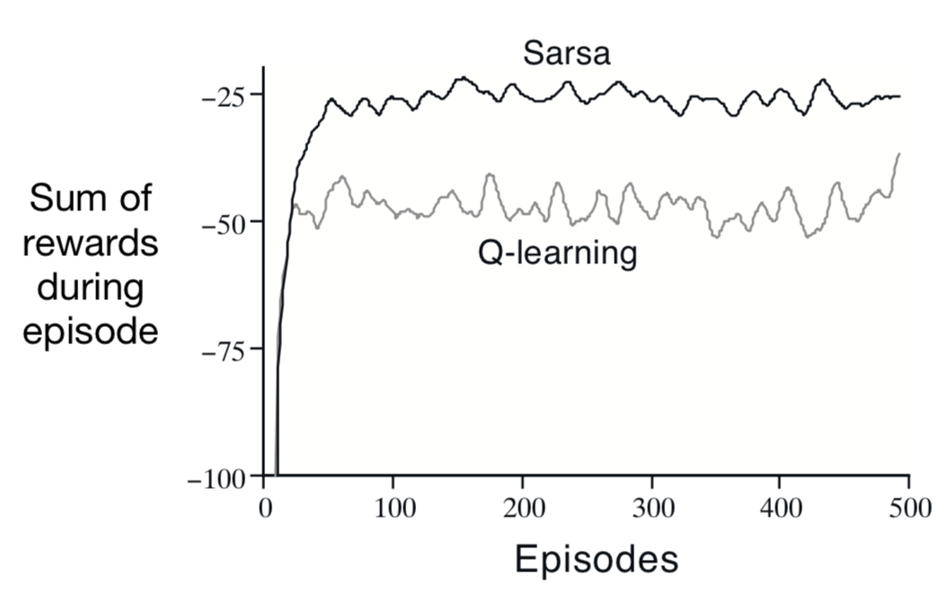

Slide 13
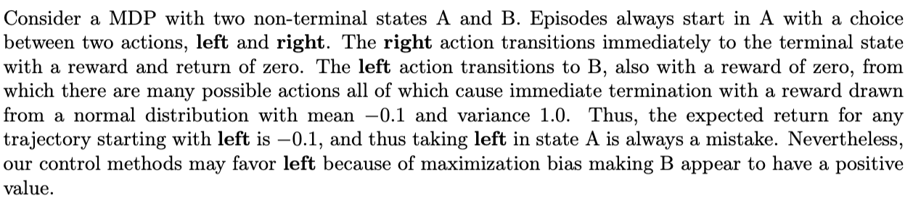
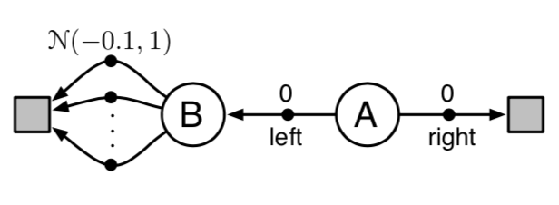
Effects of Maximization Bias*

Slide 14
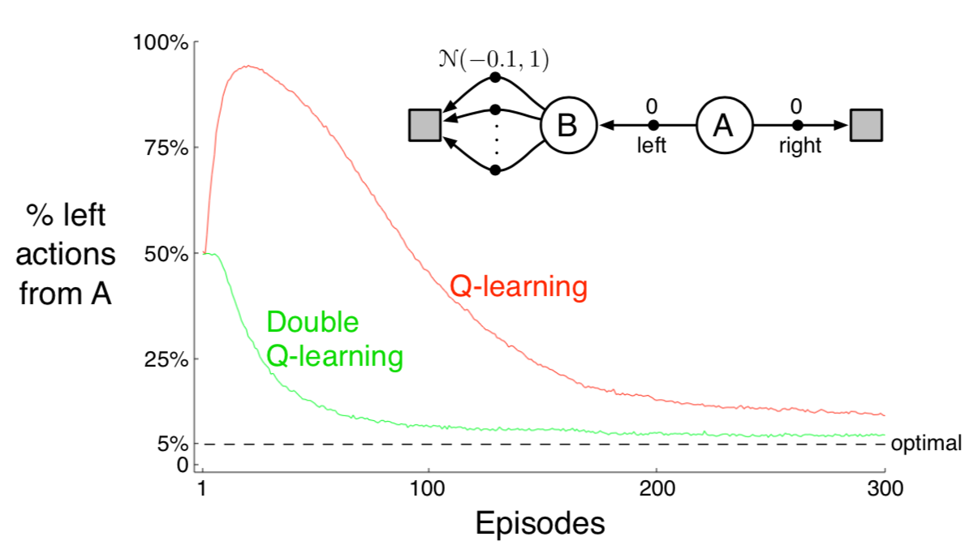
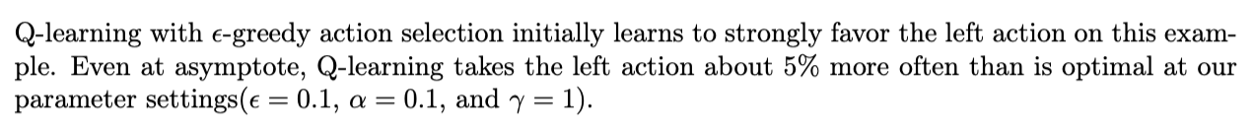

Slide 15
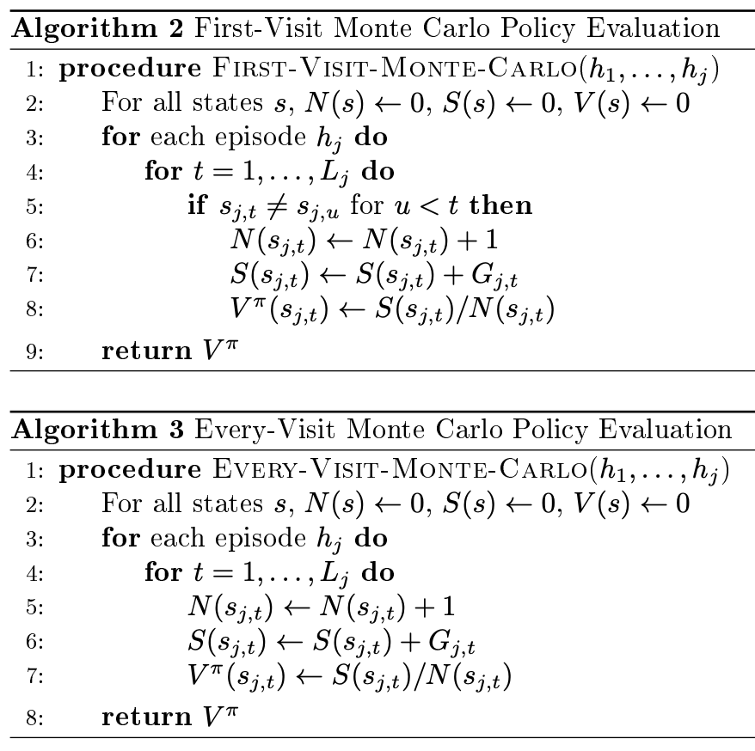
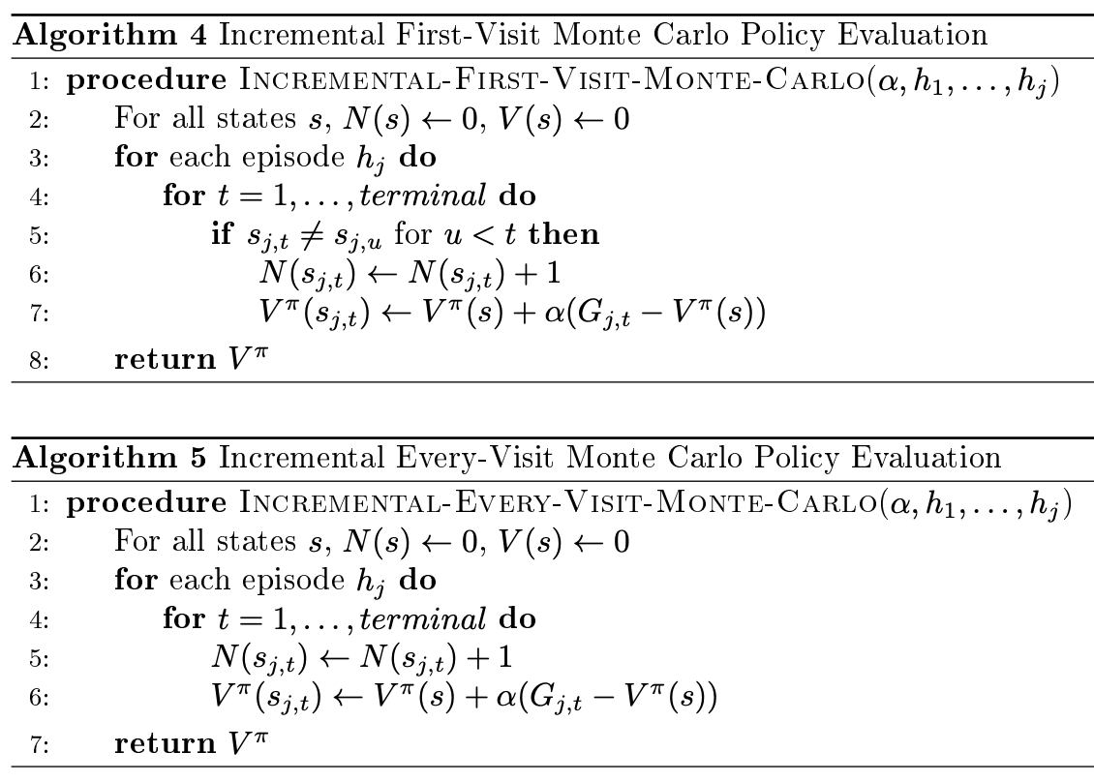
Model-free Evaluation (Monte Carlo)

Slide 16
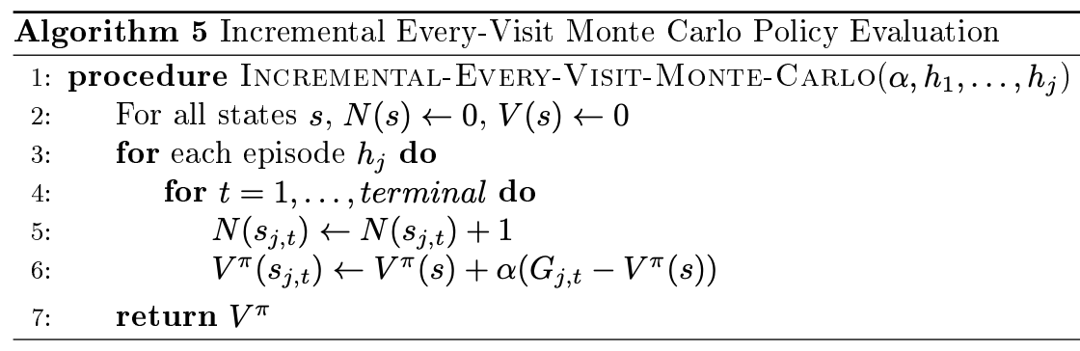
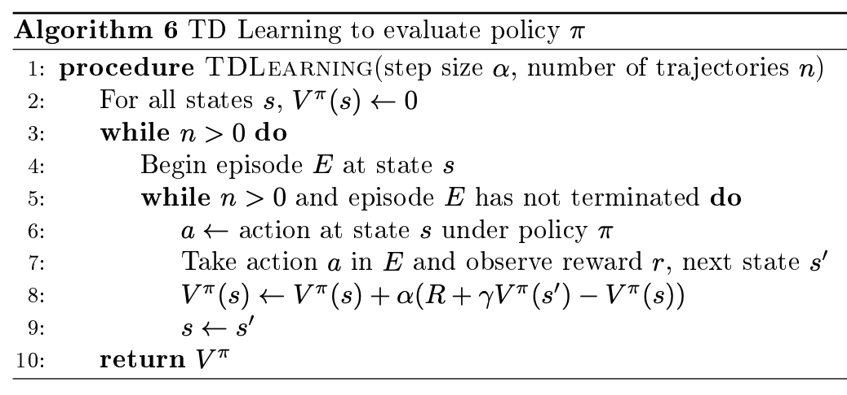
Model-free Evaluation (Temporal Difference)

Slide 17
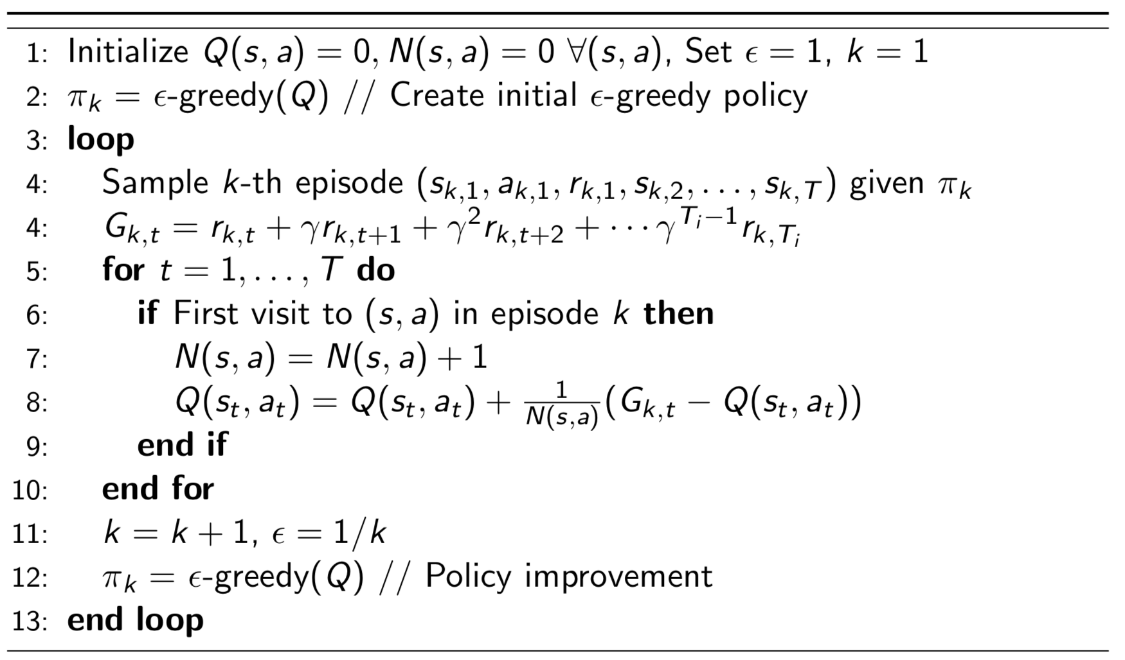
MC Control

Slide 18
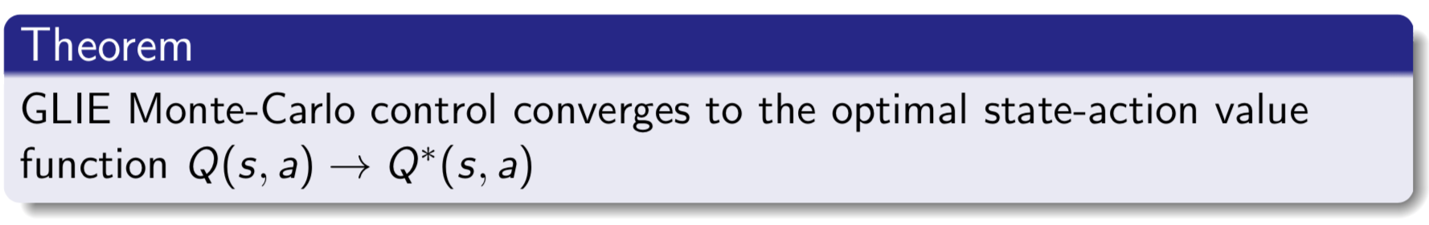
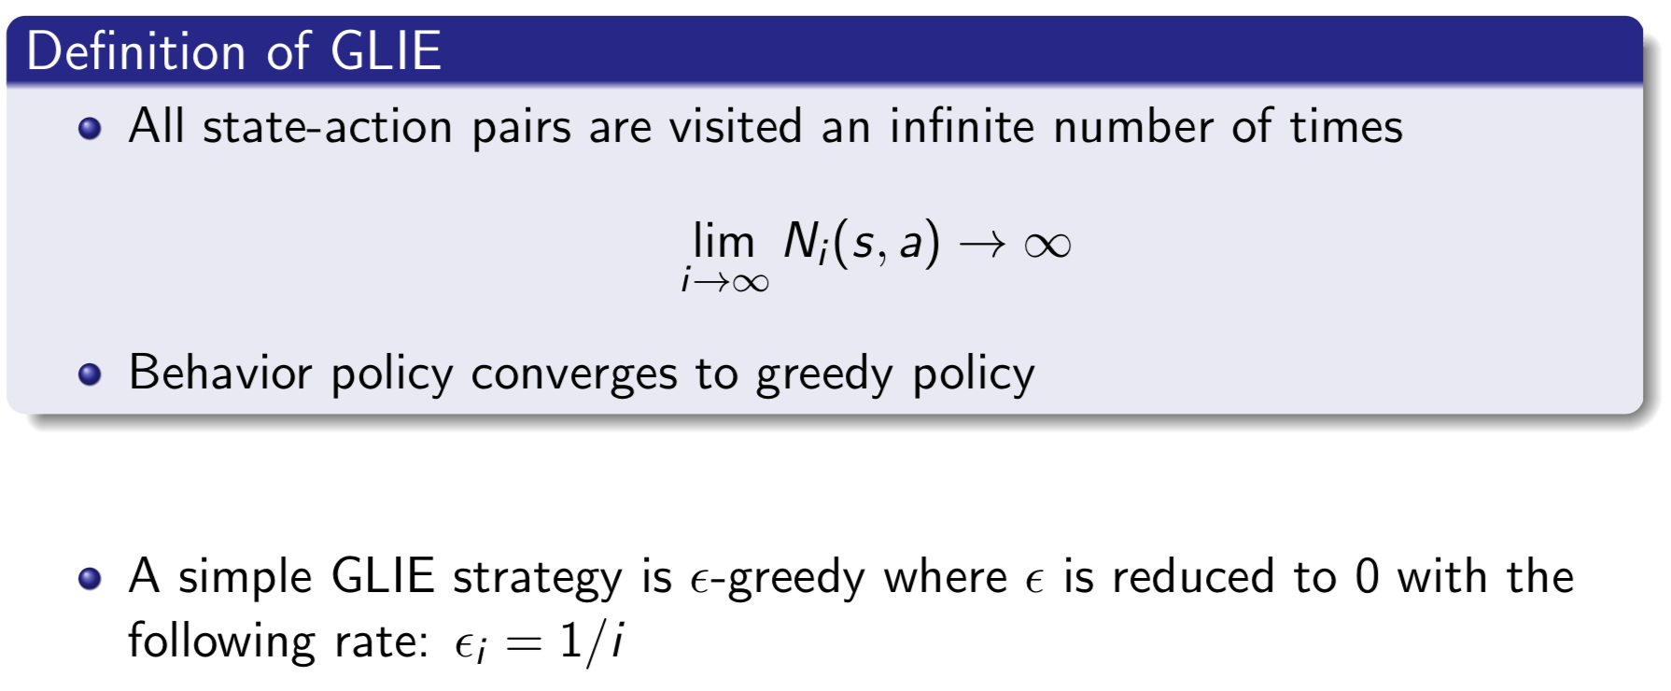
Convergence of MC Control

Slide 19
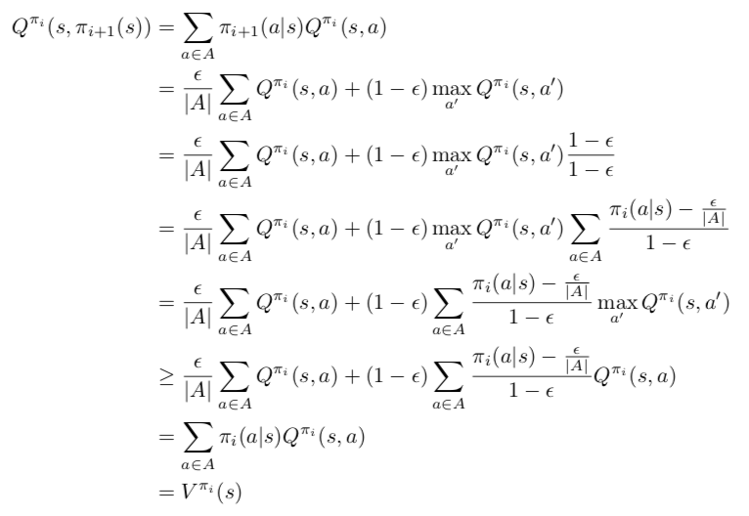
Proof of Monotonic e-greedy Policy Improvement

Slide 20
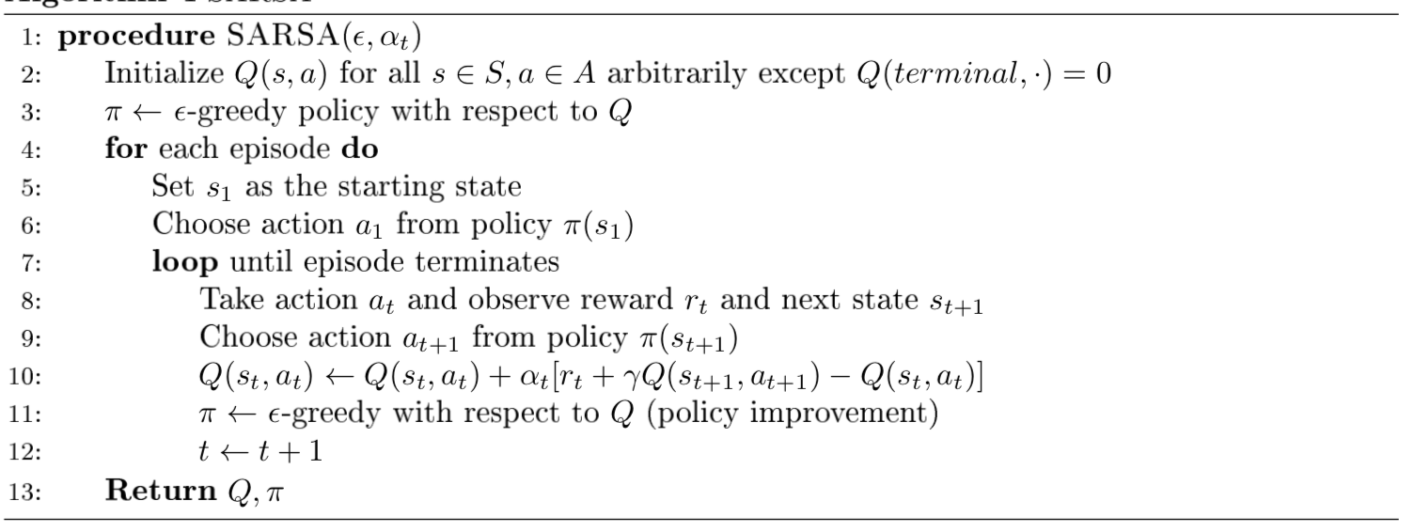
SARSA

Slide 21
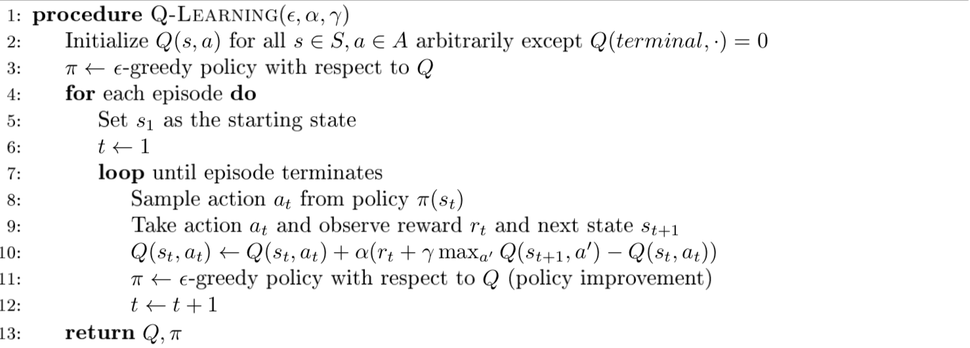
Q-learning

